Slide 1
How Archaeologists Are Using Deep Learning to Dig Deeper
Victor Irekponor
Uma Gupta
25th October, 2022

Slide 2
Motivation
Why is this topic of relevance?

Slide 3
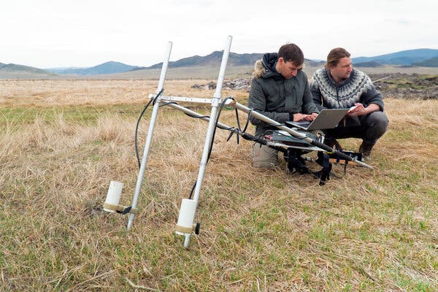
Problem
The New-York times Article narrates the experience of Dr. Gino Caspari, a research archaeologist with the Swiss National Science Foundation.
His research
Dr. Caspari, right, during a geophysical survey of a Scythian tomb in Southern Siberia in 2018. Source: Trevor Wallace

Slide 4
Data

Slide 5
Methodology

Slide 6
Results

Slide 7
Reference

